Slide 1
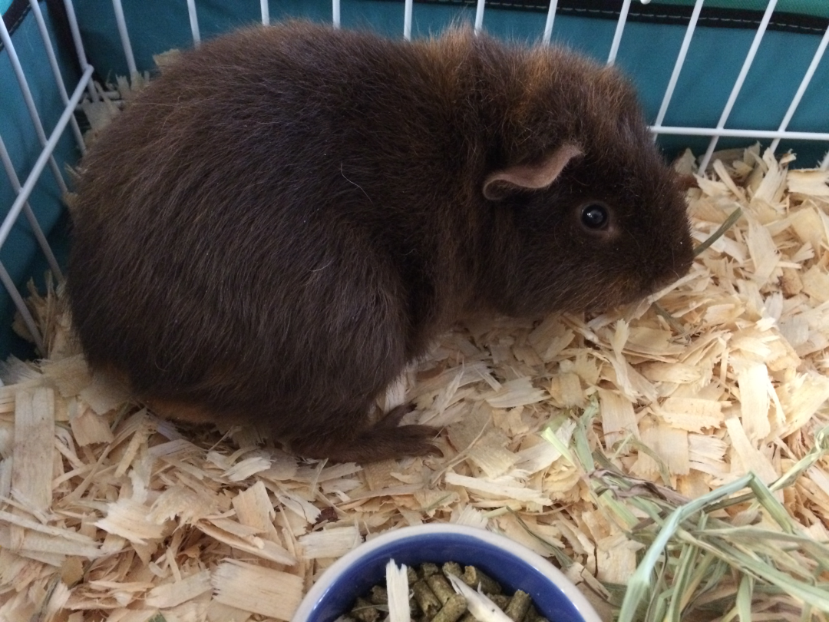
10 /10/14 Period 1
Attendance
Check and go over Density practice from yesterday.
Educational video on lightning.

Slide 2
10 /10/14 Period 3
Attendance
Check worksheet from yesterday and go over.
Educational video on lightning!!

Slide 3
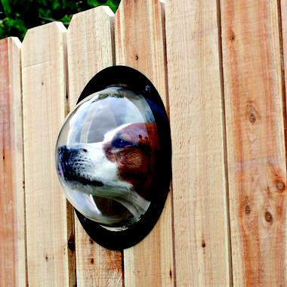
Using your senses is called:
Observation

Slide 4
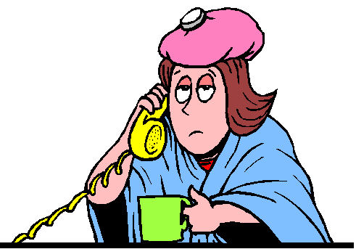
An assumption made on observations is called an
Inference

Slide 5
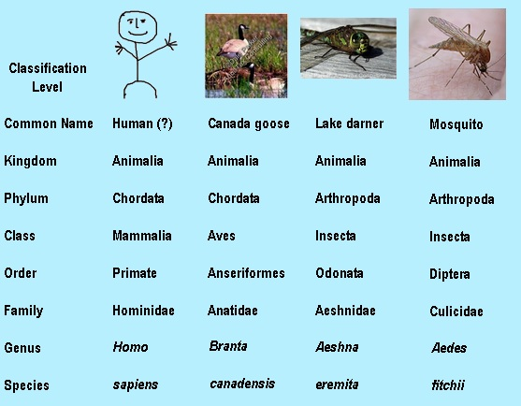
Grouping according to common characteristics is called
Classification

Slide 6
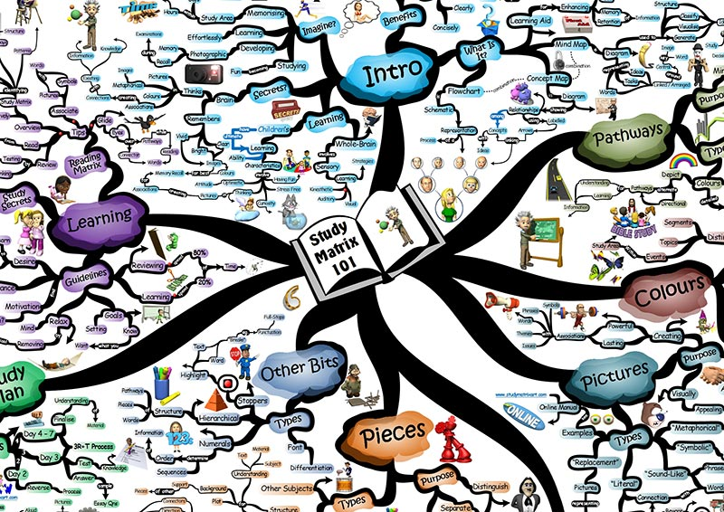
Why do we classify?
To make study easier

Slide 7
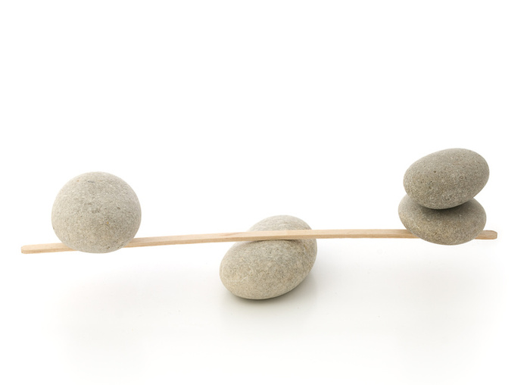
The amount of matter in an object is called
mass

Slide 8
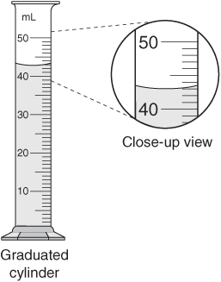
The amount of space an object occupies is called
volume

Slide 9
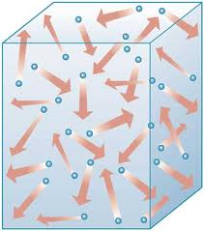
The concentration of matter in an object is called
Density

Slide 10
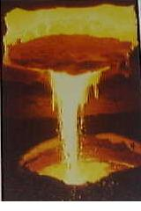
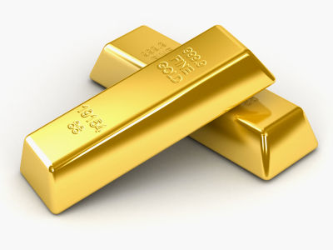
Usually solids are ______ dense than liquids.
more

Slide 11
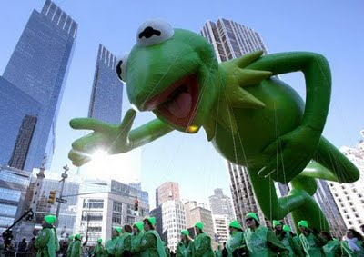
As temperature of air increases, the density ________.
decreases

Slide 12
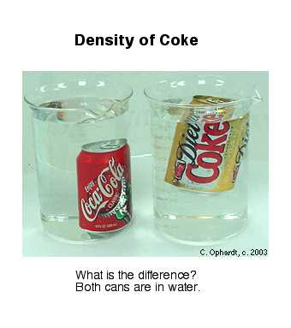
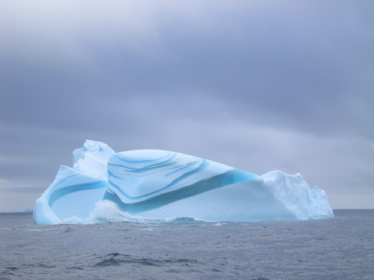
Less dense objects will
float

Slide 13
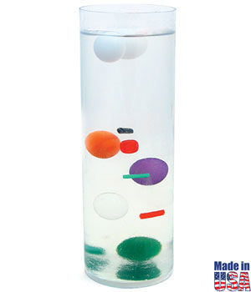
If an object and the liquid has the same density the object will remain
Suspended

Slide 14
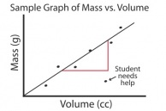
No matter the size of the sample, the density of a substance
Stays the same

